Slide 1
Dr. Yifeng Zhu Barrows 271
ECE 271 - Microcomputer Architecture and Applications
ECE271
Spring 2020

Slide 2
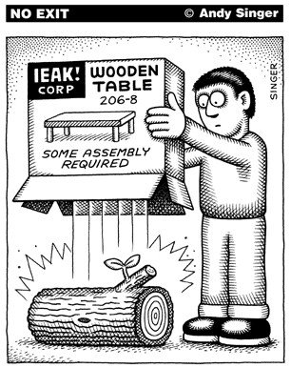
Assembly Programs
http://www.andysinger.com/

Slide 3
Why do we learn Assembly?
Assembly isn’t “just another language”.
Help you understand how does the processor work
Assembly program runs faster than high-level language. Performance critical codes must be written in assembly.
Use the profiling tools to find the performance bottle and rewrite that code section in assembly
Latency-sensitive applications, such as aircraft controller
Standard C compilers do not use some operations available on ARM processors, such ROR (Rotate Right) and RRX (Rotate Right Extended).
Hardware/processor specific code,
Processor booting code
Device drivers
A test-and-set atomic assembly instruction can be used to implement locks and semaphores.
Cost-sensitive applications
Embedded devices, where the size of code is limited, wash machine controller, automobile controllers
The best applications are written by those who've mastered assembly language or fully understand the low-level implementation of the high-level language statements they're choosing.

Slide 4
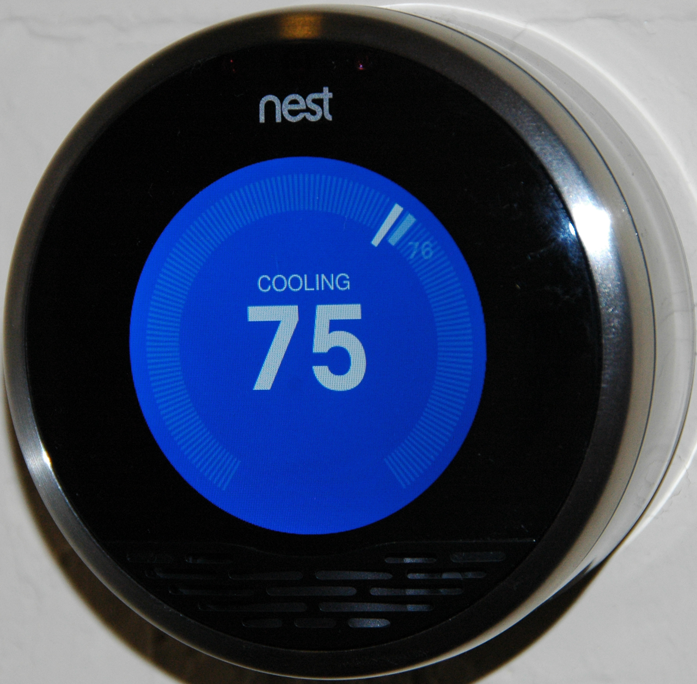
Google closes $3.2 billion purchase of Nest

Slide 5
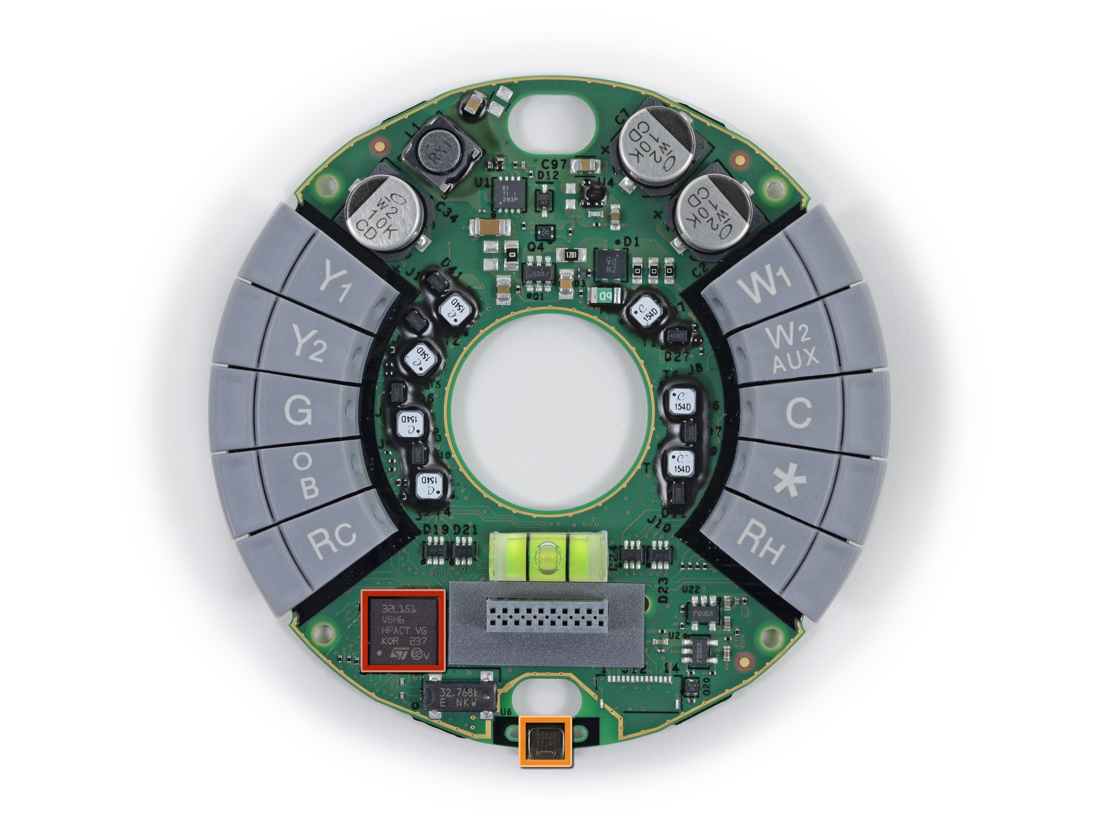
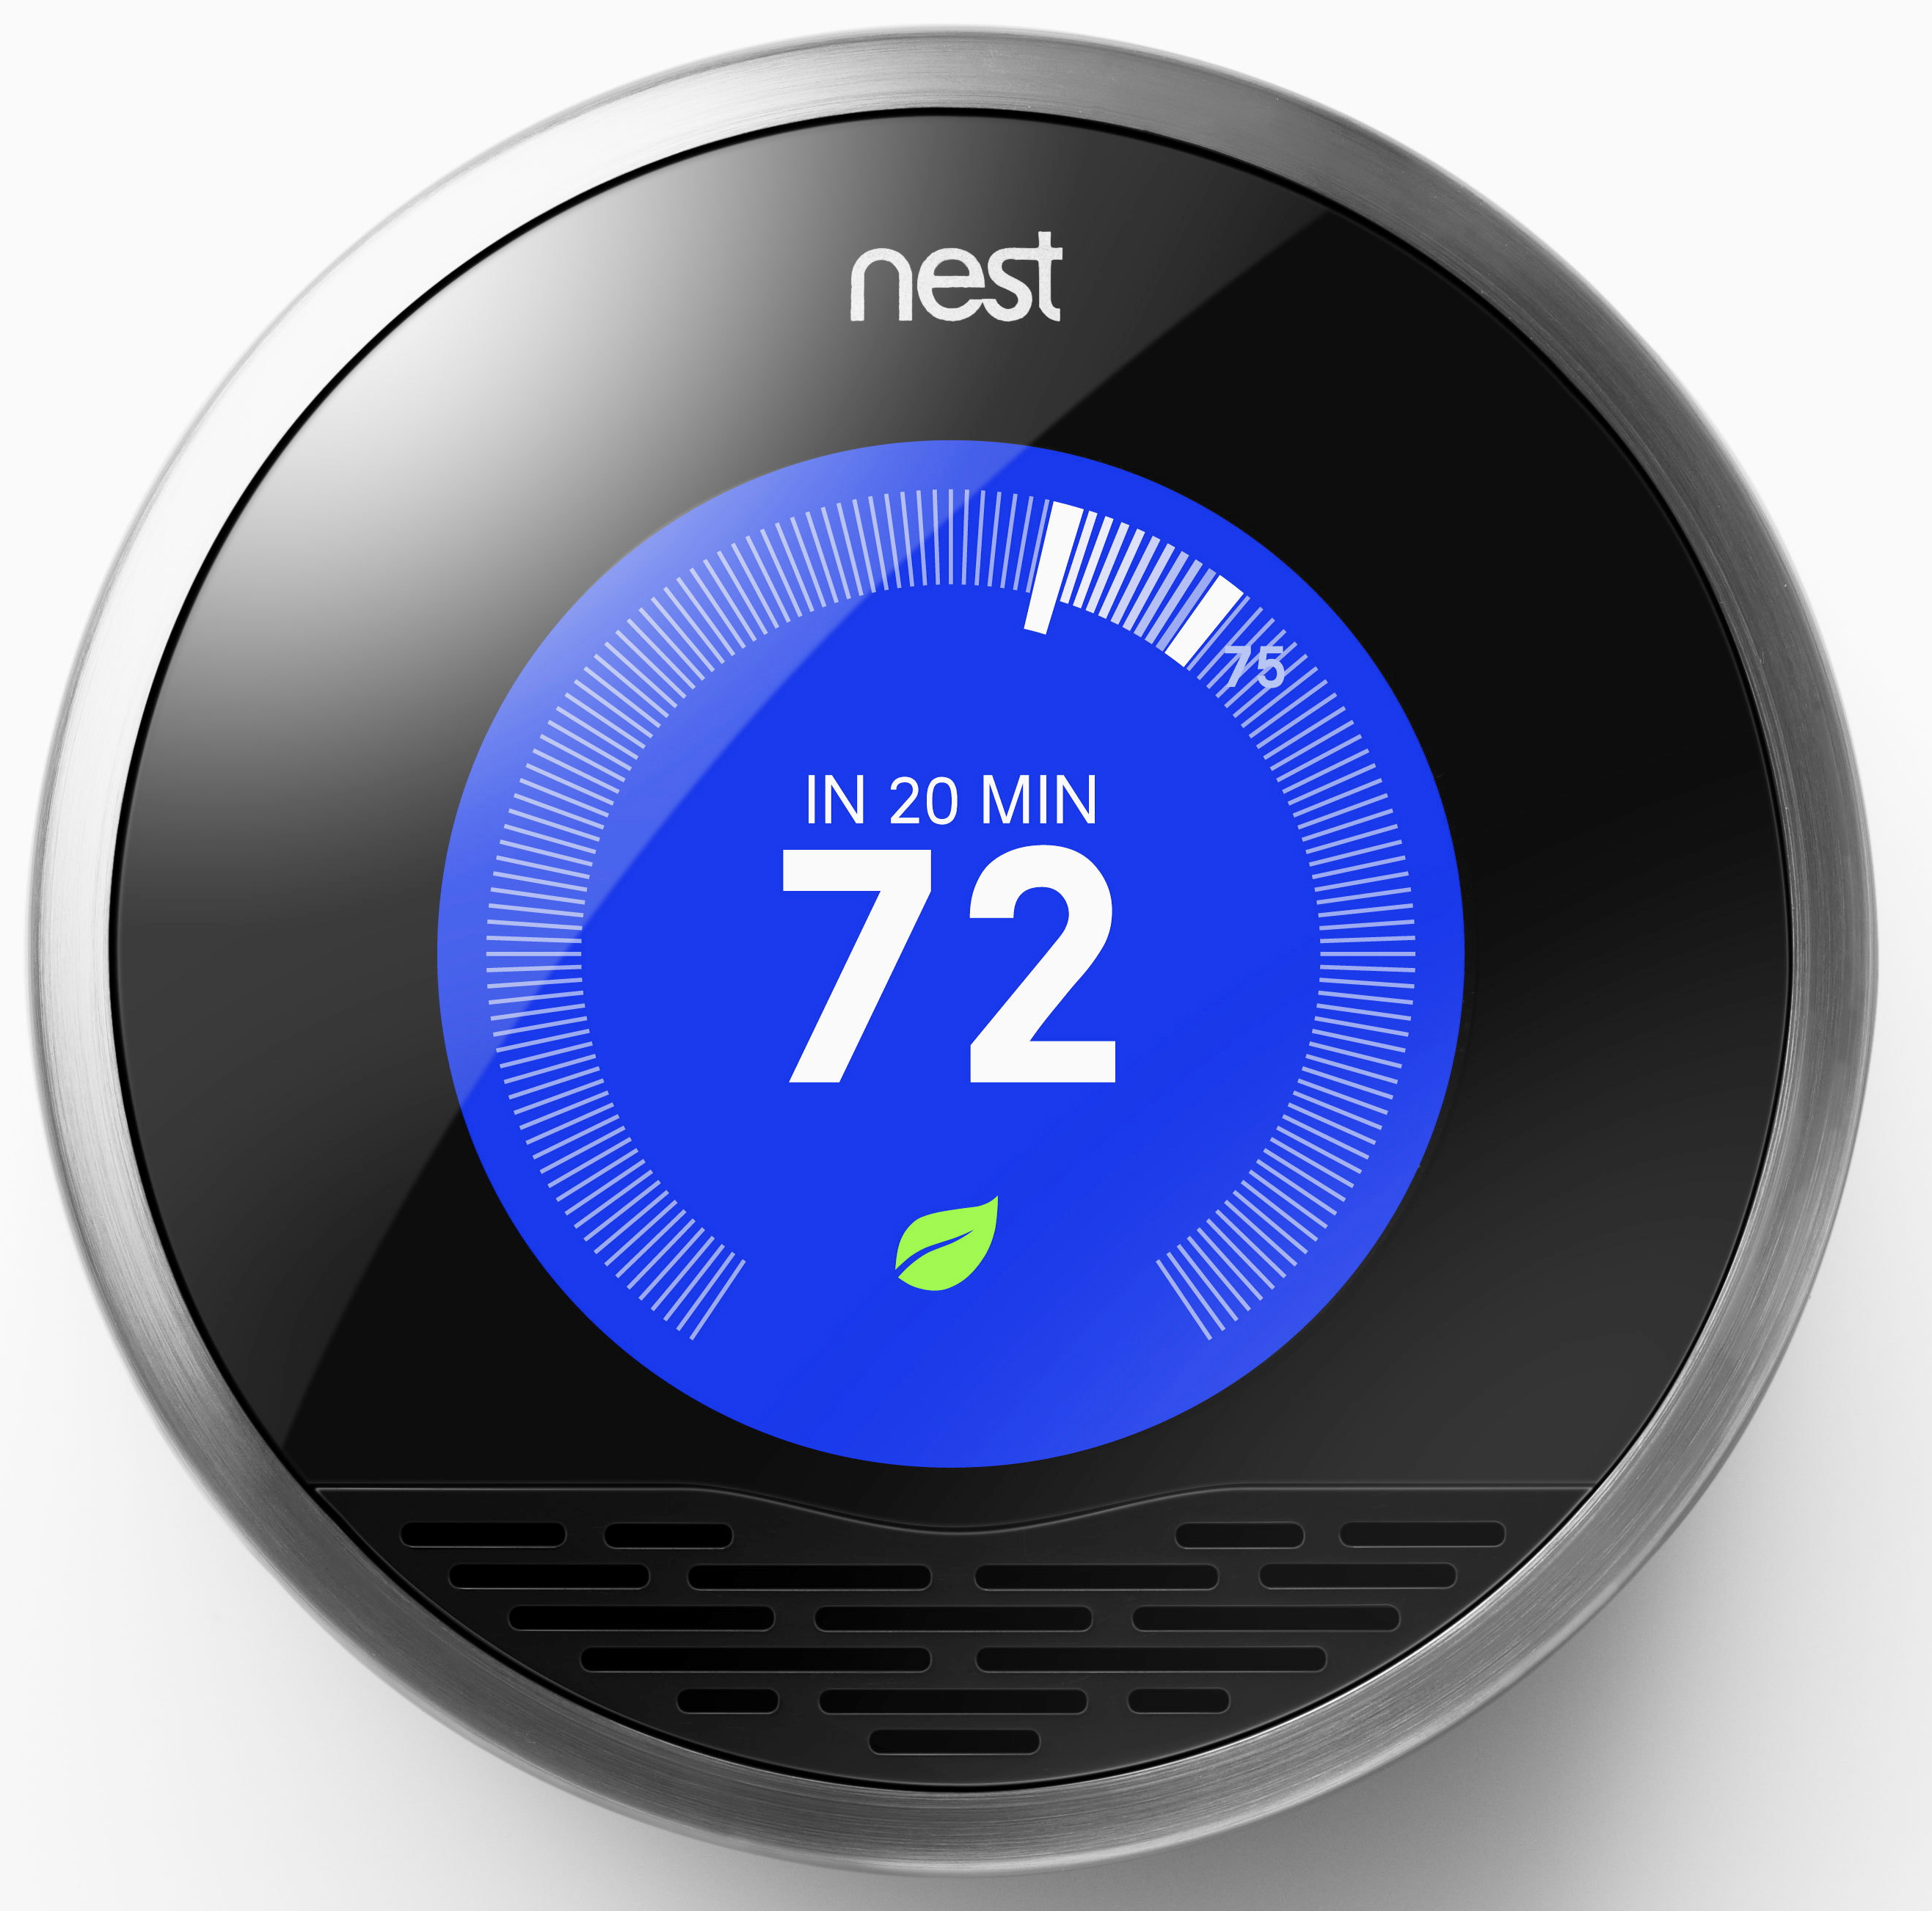
Nest 1.0
source: ifixit.com
ST Microelectronics STM32L151VB ultra-low-power 32 MHz ARM Cortex-M3 MCU

Slide 6
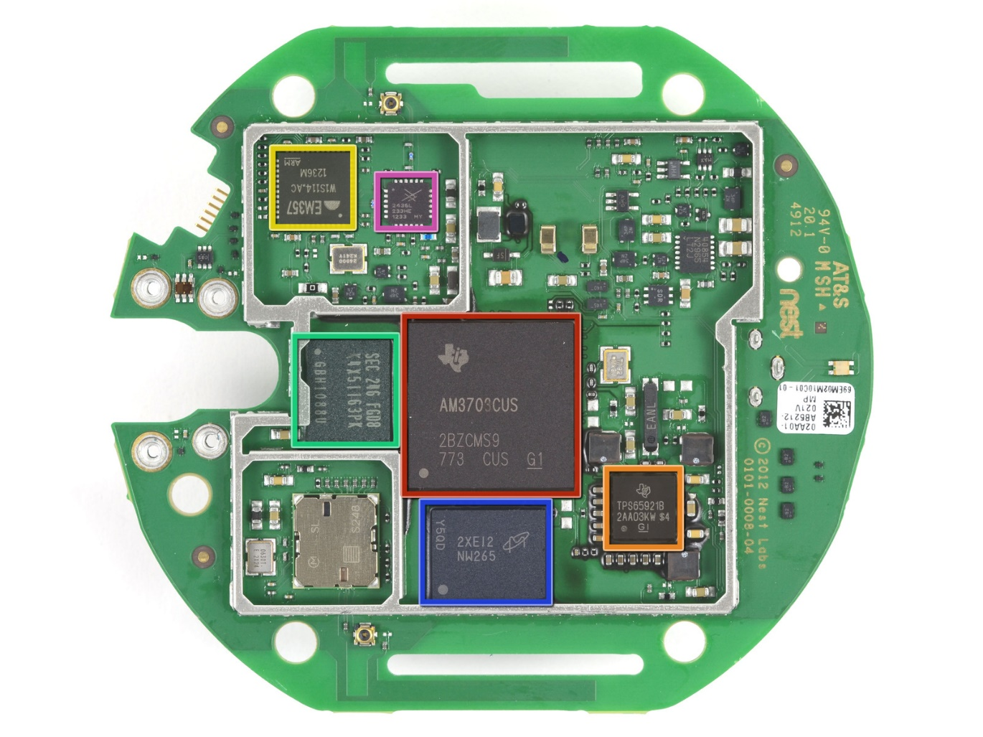
NEST 2.0
Texas Instruments AM3703CUS Sitara ARM Cortex A8 microprocessor

Slide 7
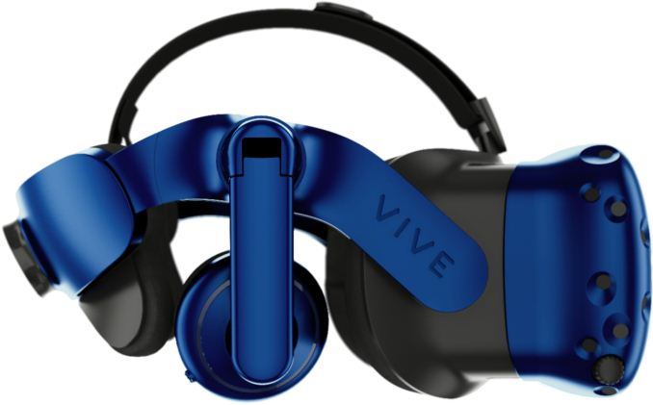
HTC Vive Pro

Slide 8
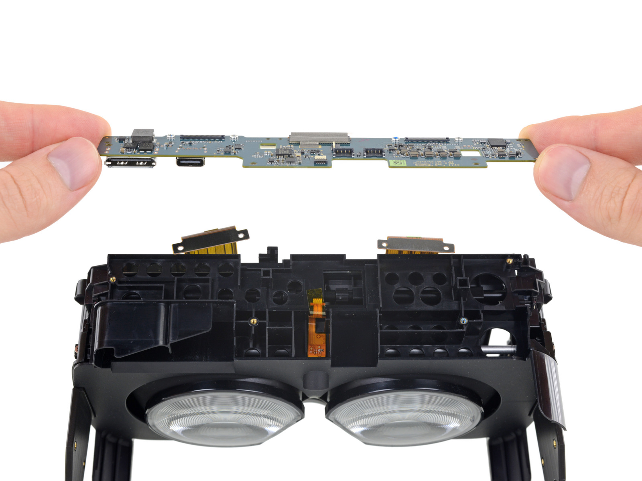
HTC Vive Pro

Slide 9
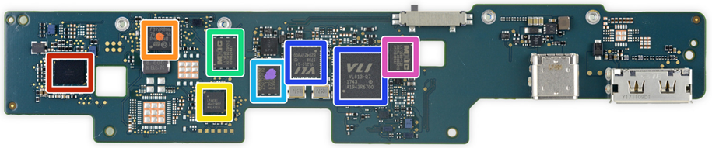
HTC Vive Pro
STMicroelectronics F072RBH6 ARM Cortex-M0 Microcontroller (same as before)

Slide 10
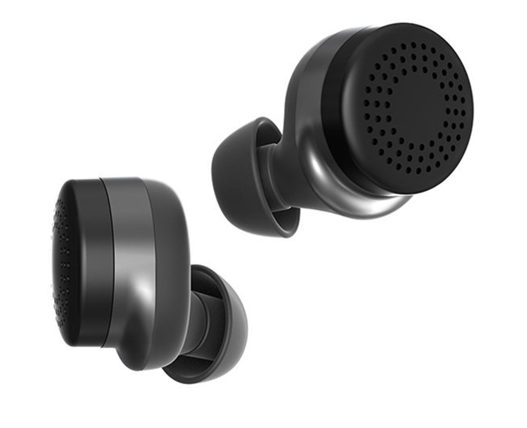
Here One Earbuds: 3-in-1 Noise Cancelling

Slide 11
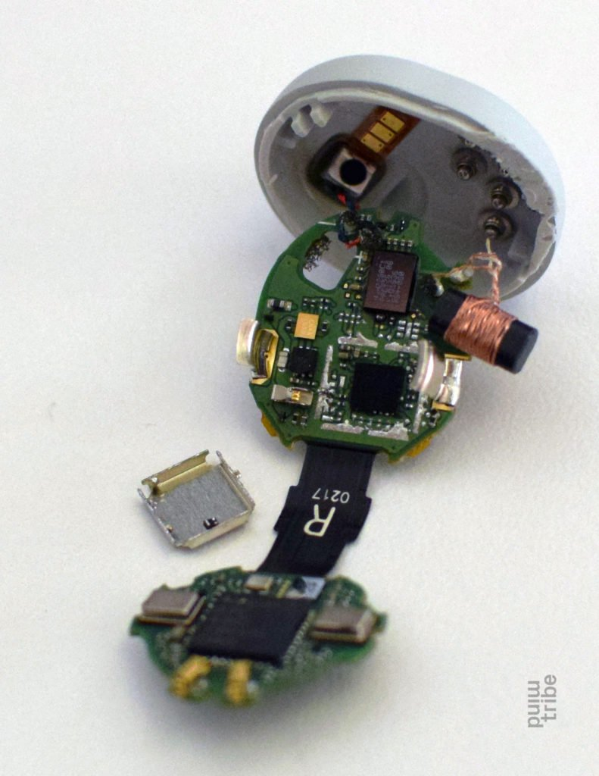
Here One Earbuds: 3-in-1 Noise Cancelling
STM32F411CE ARM Cortex-M4 core with DSP and FPU

Slide 12
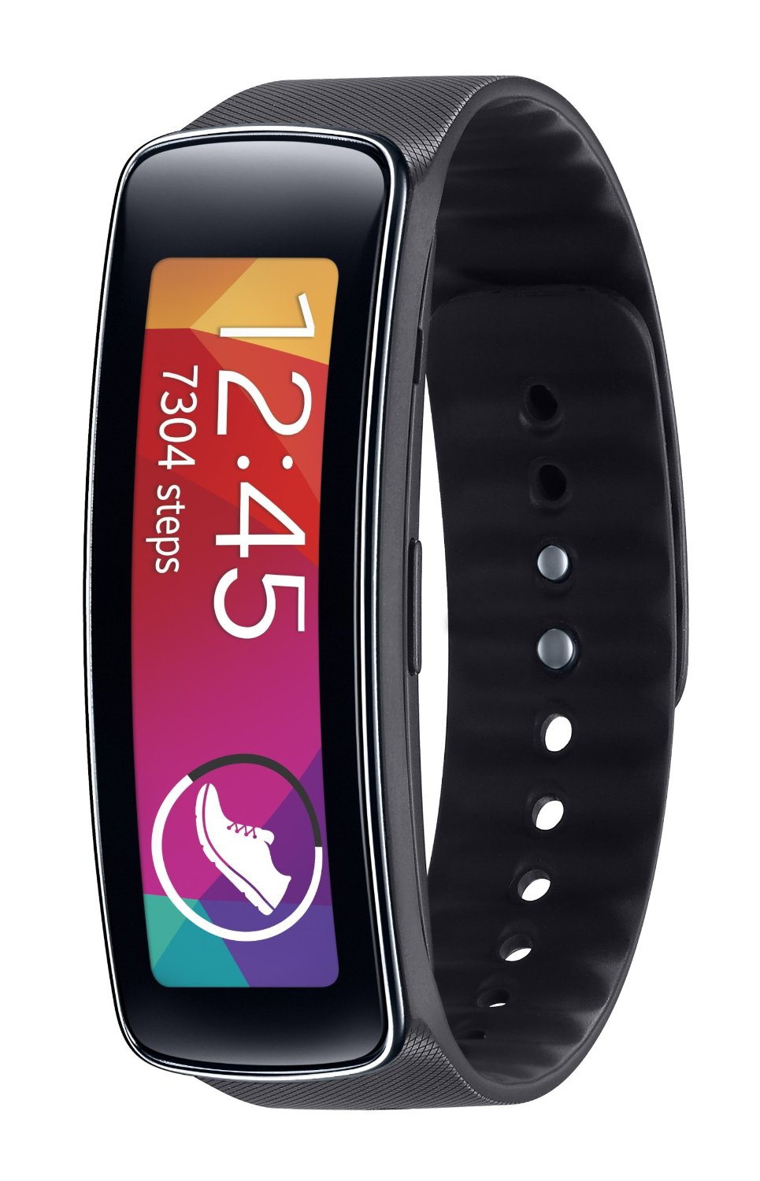
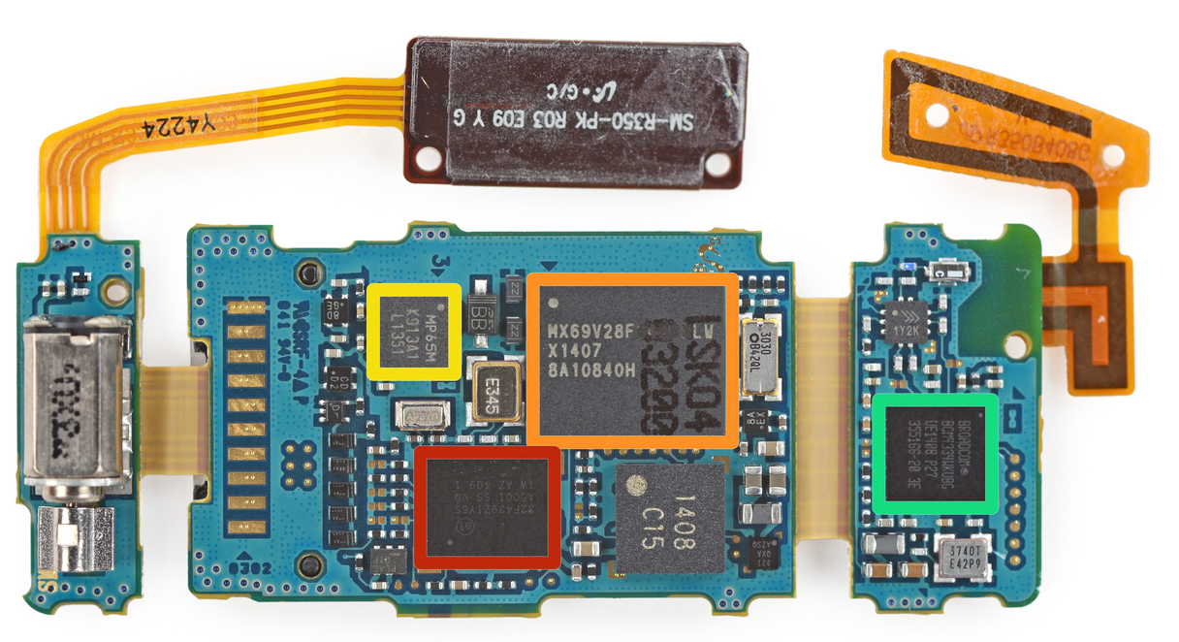
Samsung Gear Fit Fitness Tracker
source: ifixit.com
STMicroelectronics STM32F439ZI 180 MHz, 32 bit ARM Cortex-M4 CPU

